Slide 1
CONTROL TOWER
USER MANUAL
Construction

Slide 2
Construction
Main Sessions
Material Receipt At Site
Site Inventory and Material Issue for Construction

Slide 3
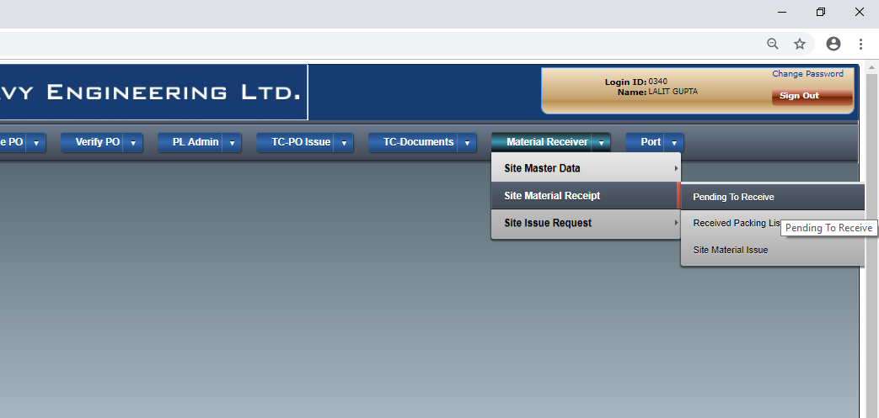
Material Receipt At Site

Slide 4
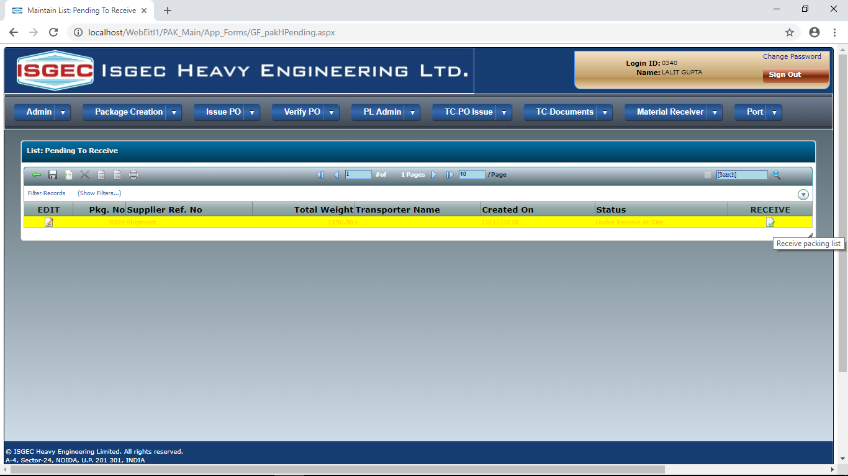

Slide 5
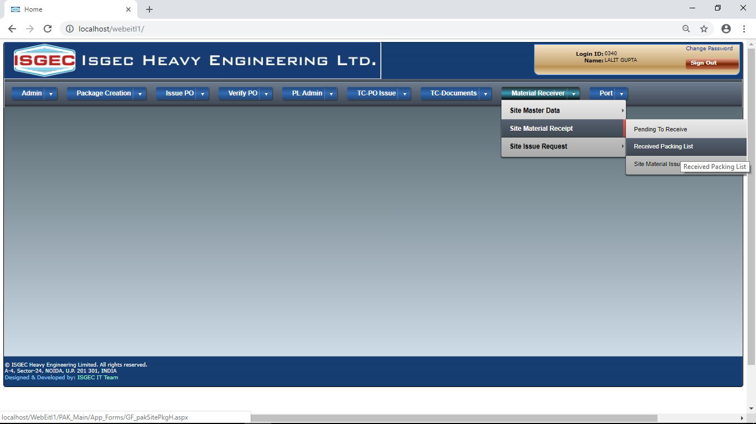
Site Inventory and Material Issue for Construction

Slide 6
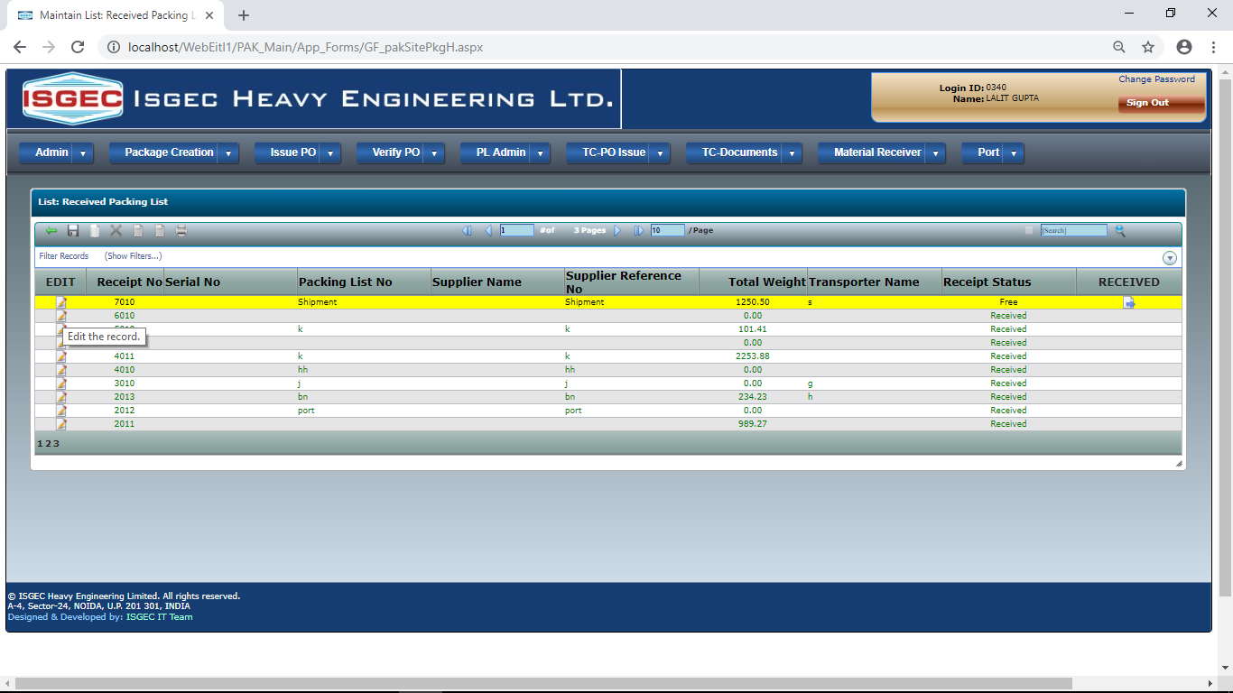

Slide 7
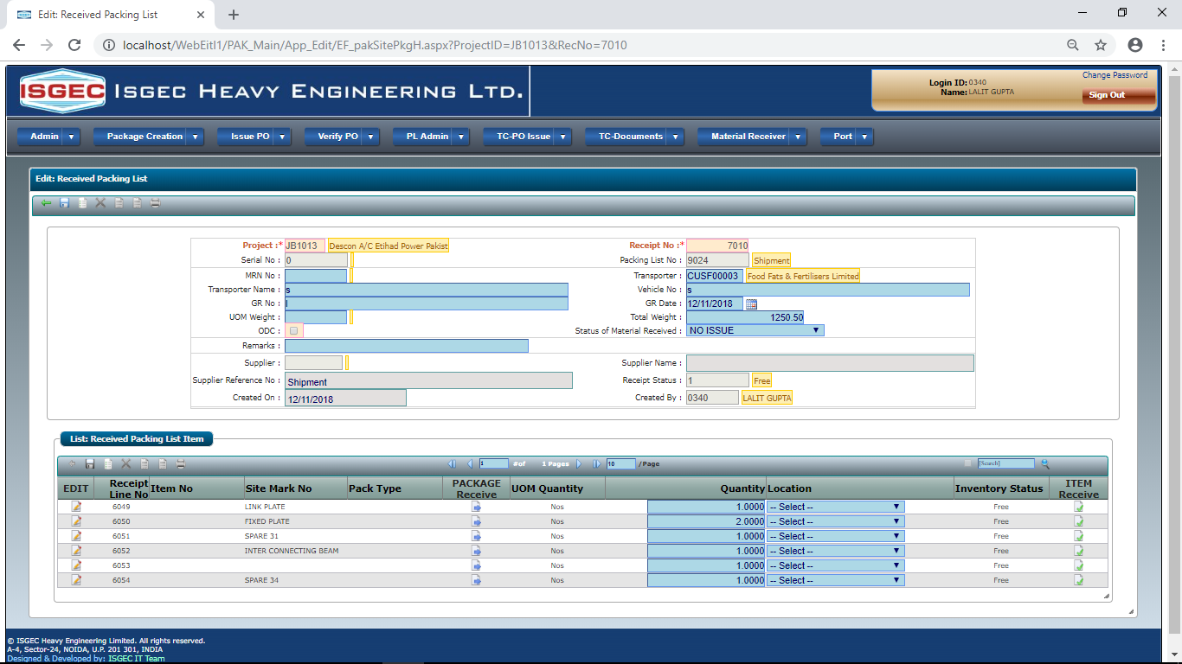

Slide 8
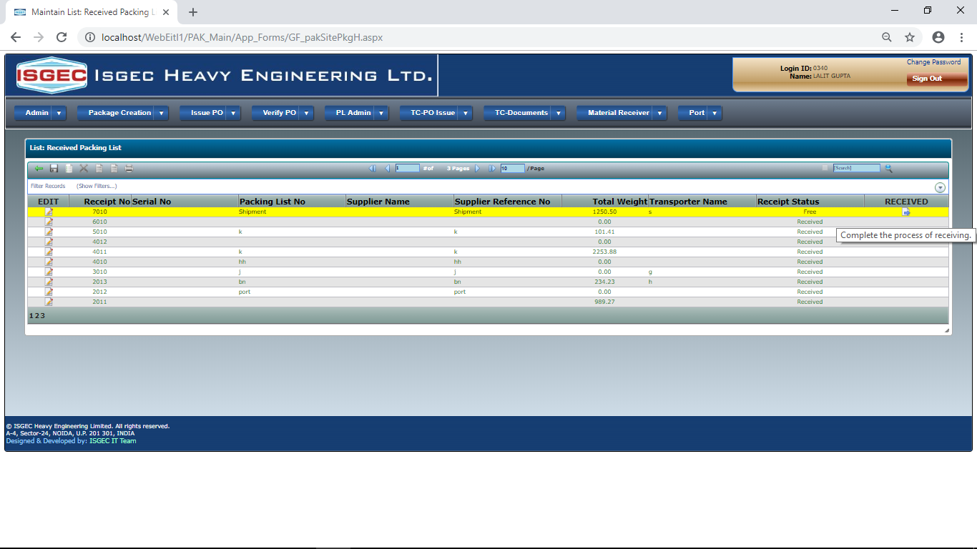

Slide 9
END

